Slide 1
September 6th,2016
The moderate program
Sequence two
Me and my family
Planning Learning
Supervised by Mr Merzougui

Slide 2
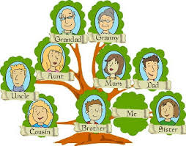

Slide 3
Situation One
Initial situation /Input
You have a computer at home and you are using the internet, facebook, viber. Your e pals from an other country is eager to know about your family , You find an email in your e-box. Respond to your e pal and draw your family tree ,add information about (age, job,favourite hobbies,likes ,…….)

Slide 4
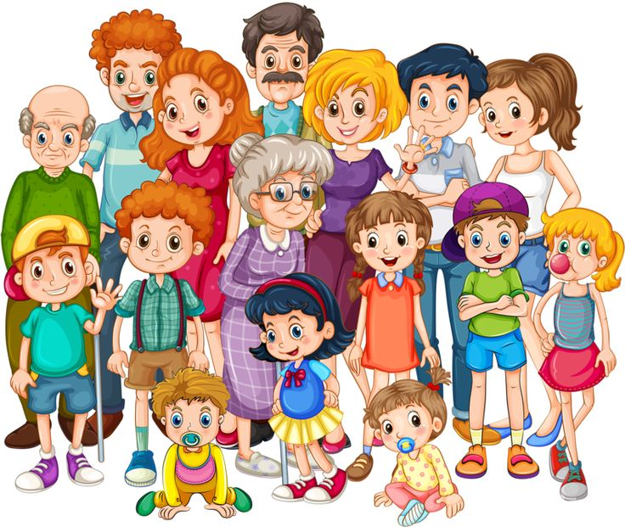
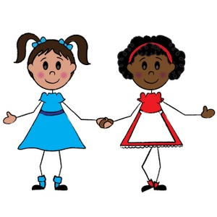
Session 1: Situation One
Initial situation /Input
It’s my family photo . It ‘ s large family
She is my mother,she is a nurse.
Oh, nice.It’s a large family. Who is she?
Is he your father ?
Yes, he is.I love my dad very much.

Slide 5
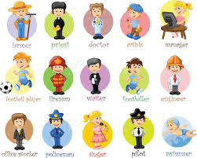

Slide 6
Session 1: target Structure:
My Family / To Be
Lesson Focus: Listening ,speaking ,and writing
Learning Objectives:By the end of the lesson ,my learners will be able to use the auxiliary to be (aff/Neg/Inter), Talking about different members of the family and their jobs.
Language input: to be (am,is,are) ,,pronouns the definite /indefinite article “a”,”the” , (I,you,she,he,we,they),adverb (not) wh question (what,who,where), prepositions (in,at) vocabulary(family ,sibling) pronunciation (i: , e),(θð) intonation on wh questions. ; functions needed for oral communication with specific vocabulary, etc.
Learning Strategies: Oral , Listening , writing
Resources:: audiovisual visual, posters,worksheets,flashcards….
Framework: PPU

Slide 7
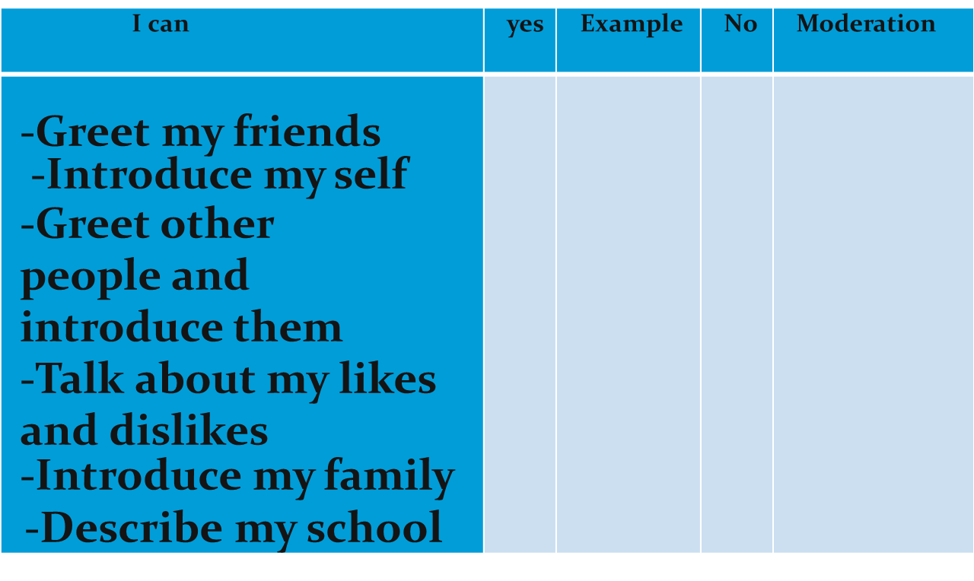
Learner’s assessment grid for the oral competence

Slide 8
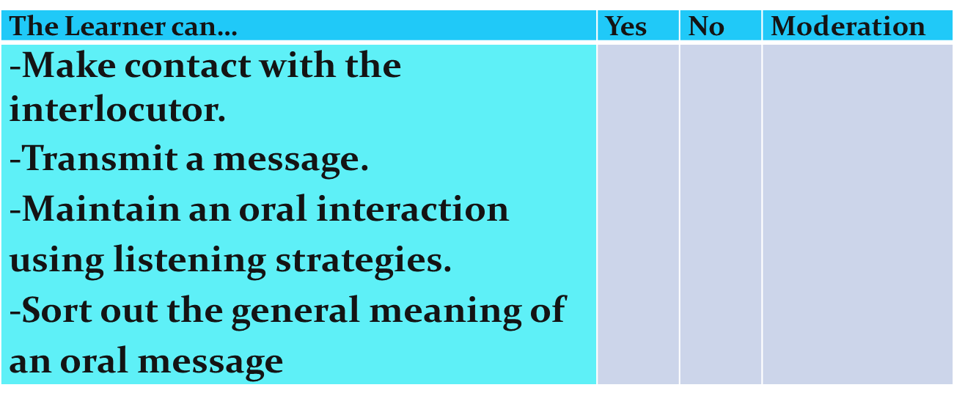
Teacher’s assessment grid for oral interaction

Slide 9
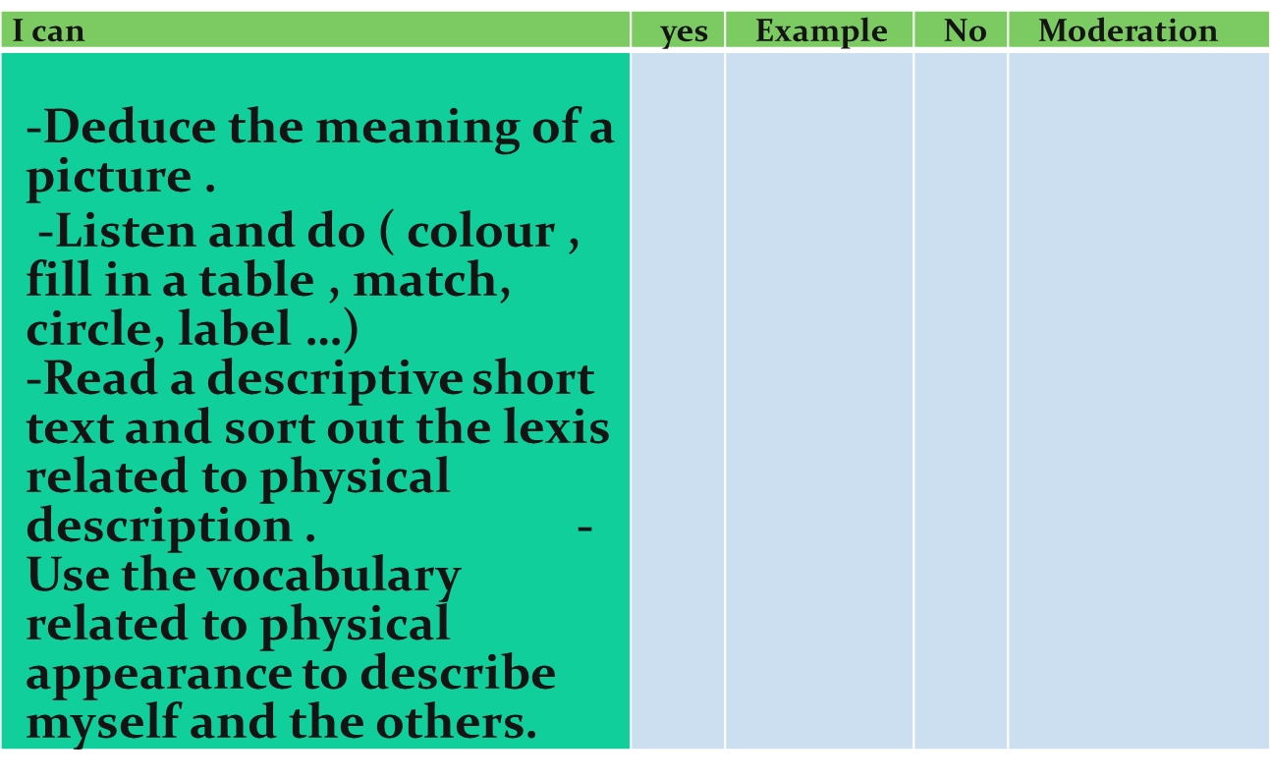
Learner’s assessment grid related to the oral interpretive competence

Slide 10
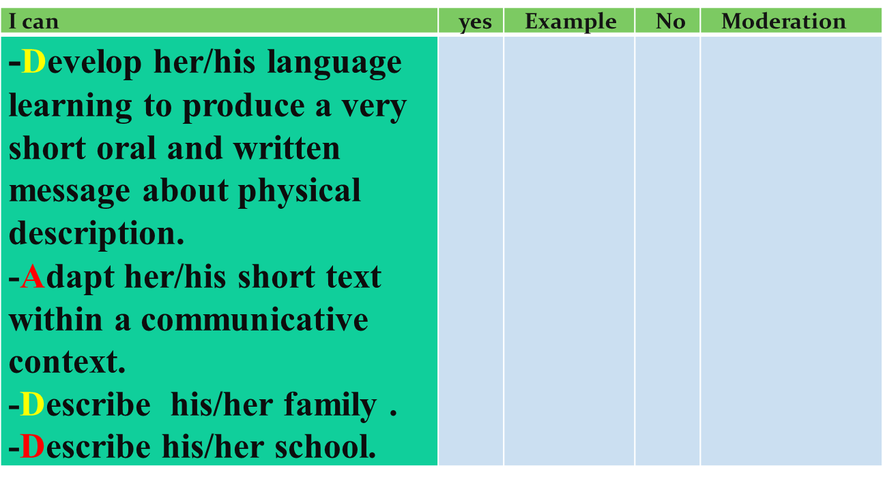
Teacher’s assessment grid related to oral messages

Slide 11
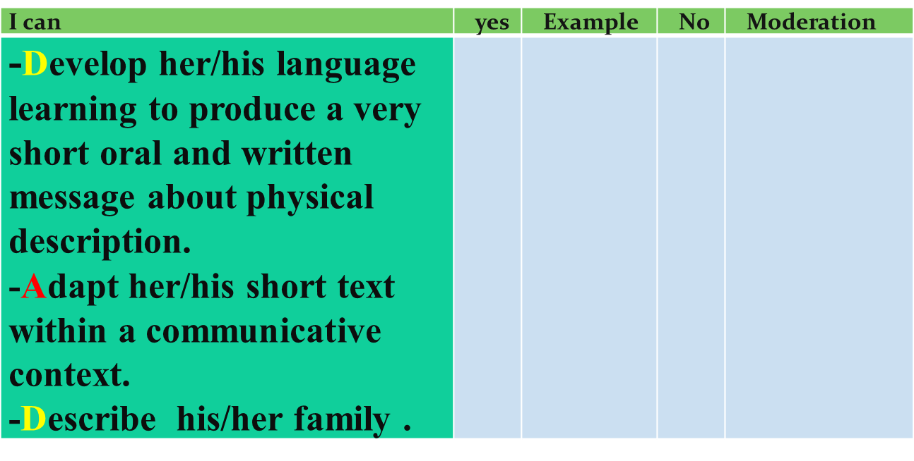
Teacher’s assessment grid related to oral messages

Slide 12
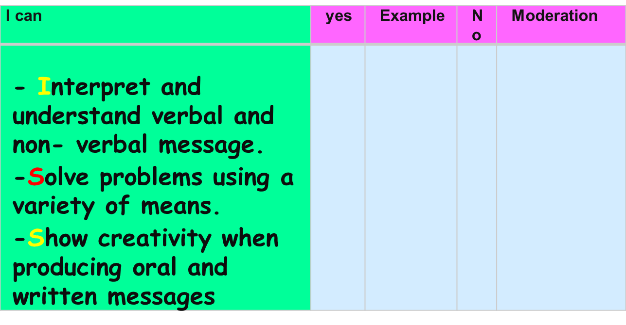
Learner’s assessment grid for cross-curricular competences
1- intellectual competence

Slide 13
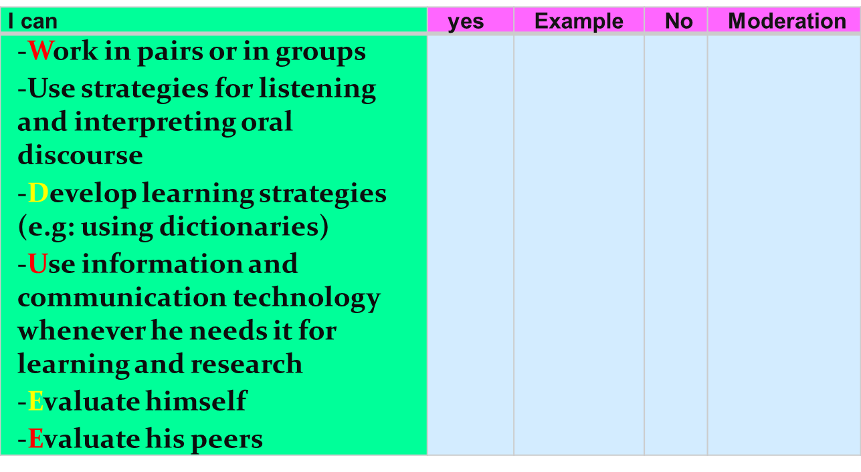
Learner’s assessment grid for cross-curricular competences
2-Methodological competence

Slide 14
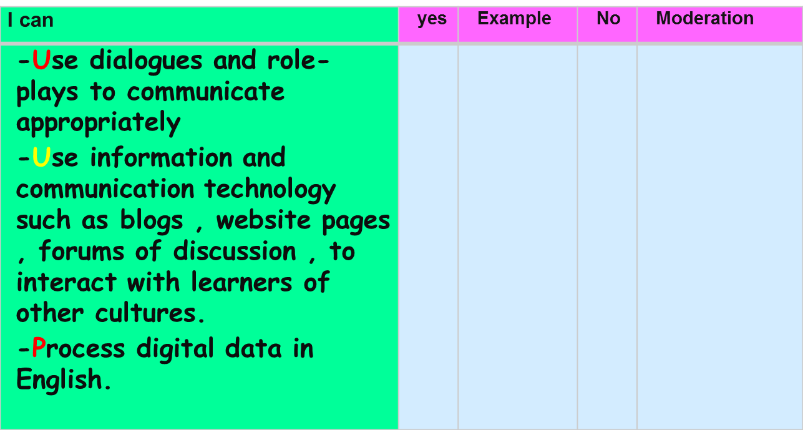
Learner’s assessment grid for cross-curricular competences
3- Communicative competence

Slide 15
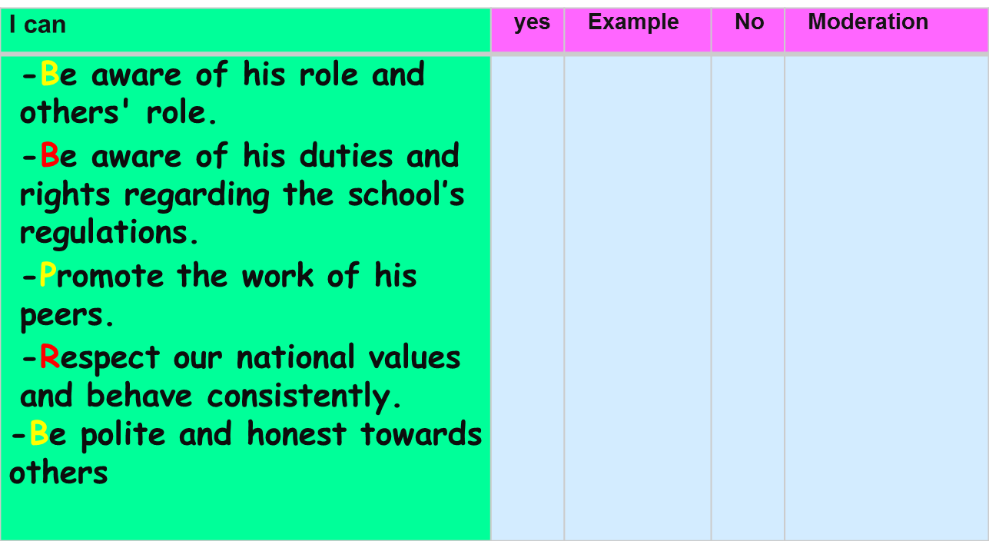
Learner’s assessment grid for cross-curricular competences
4- Personal and Social competence

Slide 16
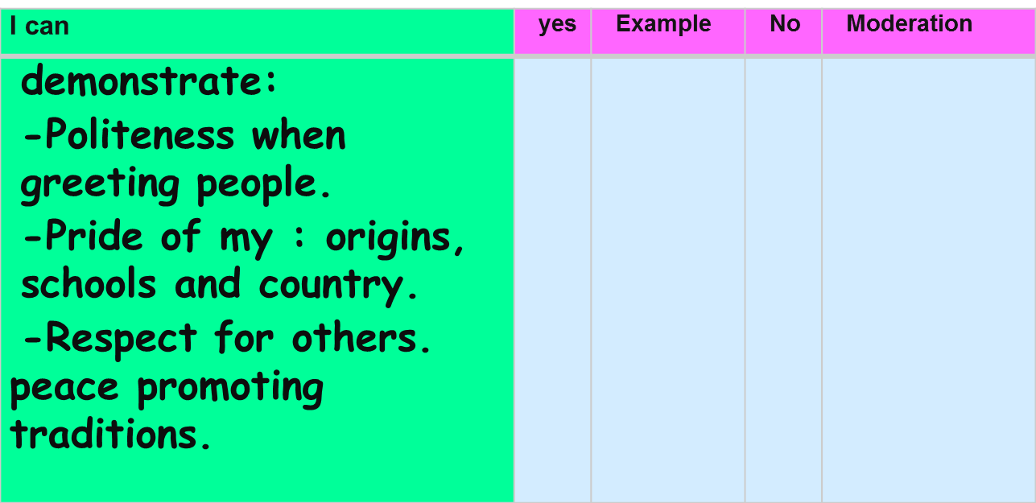
Learner’s assessment grid for values

Slide 17
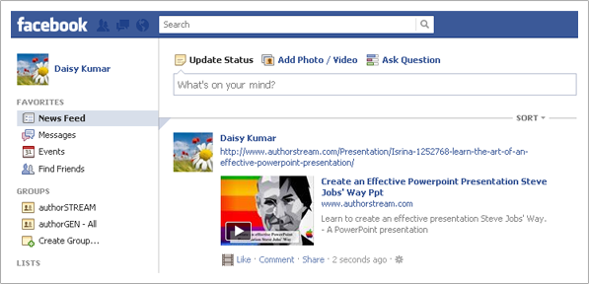

SEQUENCE TWO: Situation Two
Learning situation to install the resources/apprenticeship
You posted a photo of your family members on your facebook wall.Your e pal calls you and wants to know about them. Respond.

Slide 18
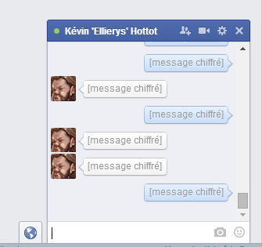
Session 2 Target Structure:What’s Your Job?
Hi,I’m tom .I’m 12 .I’m from France.
Nice to meet you Tom..
What ‘s your job ?.
I’m a doctor .
I’m an engineer ?
Yes, I am.

Slide 19
Session «2 :Target Structure
To Have (aff/neg/inter)/JOBS /numbers 14-100
Lesson Focus: Speaking and Writing
Learning Objectives:By the end of the lesson ,my learners will be able to use ‘’ have” ,name the Jobs and tell their about their age and order .
Language input: to be (am,is,are) ,,pronouns (I,you,she,he,),helping verb (do) ,wh question (what), vocabulary(family, jobs, numbers and ordinal numbers) pronunciation , intonation on questions. ; functions needed for oral communication with specific vocabulary, etc.
Learning Strategies:oral interraction, Listening ,writing
Resources:: audiovisual( visual https://youtu.be/nZUWPsn_T90 (flashcards,poster of Jobs and family members
Framework: PDP

Slide 20

Session 2Target Structure :Jobs
Resources: Video 1 audiovisual( visual https://youtu.be/nZUWPsn_T90

Slide 21

Session 2 Target Structure: Numbers (13 to 100) audiovisual( visual https://youtu.be/IcWSFE9dBi4

Slide 22


Slide 23
Session 3 Target Structure:This is ME
You have an English e-pal friend Margaret . Introduce yourself to her . Tell her about you, your village/town and your family .
Lesson Focus: Writing
Learning Objectives:By the end of the lesson ,my learners will be able to give information about themselves and write an email.
Language input: to be (am,is,are) ,,pronouns (I,you,she,he,),helping verb (do,) (like ,live,play,),wh question (what), vocabulary(family ,sibling) pronunciation (i: , e), intonation on wh questions. ; functions needed for oral communication with specific vocabulary, etc.
Learning Strategies: Oral interraction , writing
Resources:: audiovisual( visual (flashcards,poster of the school things and numbers)
Framework: PPU

Slide 24


Session 3 Target Structure: Likes/Dislikes
I like reading books it’s my favourite hobby ,how about you?
I don’t like,I love watching cartoons
Do you like sports?
Yes, I do.

Slide 25
Session 3 Target Structure: Likes/Dislikes
Lesson Focus : Listening and speaking
Learning Objectives:By the end of the lesson ,my learners will be able to express their likes and dislikes.
Language input: present simple (Like, love, dislike) helping verb (do) adverb (not) ,pronoun (it) ,wh question (what), vocabulary(HOBBIES) pronunciation , intonation on wh questions. ; functions needed for oral communication with specific vocabulary, etc.
Learning Strategies: Oral interraction , listening
Resources:: audiovisual ,visual (flashcards,poster of hobbies ,sports pets,….)
Framework: PDP

Slide 26
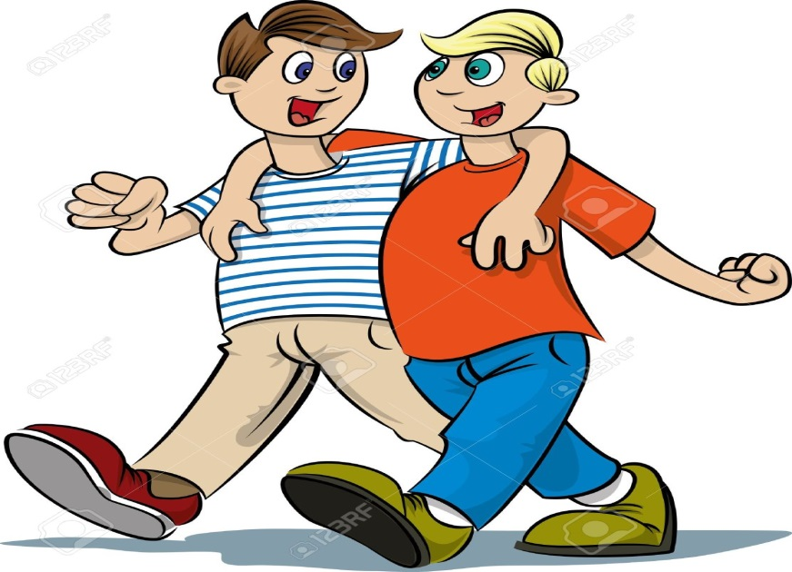
Session 16 Target Structure: Present Simple
What do you do for your free time?
Do you go to the stadium ?
I practise football on Saturday.
Yes, I do..

Slide 27
Session 17 Target Structure: Present Simple
(Like,dislike,love,go) (Aff/neg/inter)
Lesson Focus: Speaking and writing
Learning Objectives:By the end of the lesson ,my learners will be able to express their likes and dislikes.Talk about sports and hobbies.
Language input: present simple (Like, love, dislike), s for 3rd person singular, helping verb (do) adverb (not) ,pronouns ,wh question (what,where), vocabulary(hobbies,sports, food, clothes,subjects) pronunciation , intonation on wh questions. ; functions needed for oral communication with specific vocabulary, etc.
Learning Strategies: Oral interraction, writing
Resources:: audiovisual ,visual (flashcards,poster ofsports and hobbies)
Framework: PPU

Slide 28
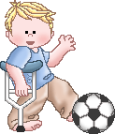

Session 4 Target Structure: Present Simple Hobbies/Sports
1.John is a reporter of a school newspaper. Here is his article about pupils
Many pupils of our school have interesting hobbies. Lara is 11 years old. She likes poems and paints pictures.
Tom is 15 years old and he has very interesting hobbies. He likes to dance ,design Internet sites and play piano.
Robert is almost 13 years old. He practises football and reads detective
stories.
Our pupils do many interesting things and they are very busy.
They also love different subjects. Tom is the best pupil at math. Lara is good at art and literature and Robert is one of the best pupils at PE. Their hobbies help them study well too.

Slide 29
Session 4 Target Structure: Present Simple Hobbies/Sports
Lesson Focus: Reading
Learning Objectives:By the end of the lesson ,my learners will be able to people hobbies.
Language input: present simple (Like, love, dislike) helping verb (do) adverb (not) ,pronoun (it) ,wh question (what), vocabulary(hobbies /sports) pronunciation , intonation on wh questions. ; functions needed for oral communication with specific vocabulary, etc.
Learning Strategies:Reading ,writing
Resources:: visual (flashcards,poster of sports and hobbies)
Framework: PDP

Slide 30
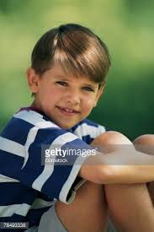
Session5 Target Structure :My blog
hi everyone,
My name is jack .i’m 13 years old and Iam new in this school .I’m from Canada.My mother is from scotland.
I’m in class 2B .i like basketball and listening to music.I have got a pet called Scruff.
Nice to meet you all.
Jack Smith

Slide 31
Session 5
Lesson Focus: Reading and writing
Learning Objectives:By the end of the lesson ,my learners will be able to give information about people life and their family.
Language input: to be ,to have ,,pronouns ,helping verb (do) ,wh question (what,where,how), vocabulary(family ,sibling,job) pronunciation (i:,I ), intonation on wh questions. ; functions needed for oral communication with specific vocabulary, etc.
Learning Strategies: Oral interraction, reading , writing
Resources:: audiovisual( visual (flashcards,posters, photos)
Framework: PDP

Slide 32
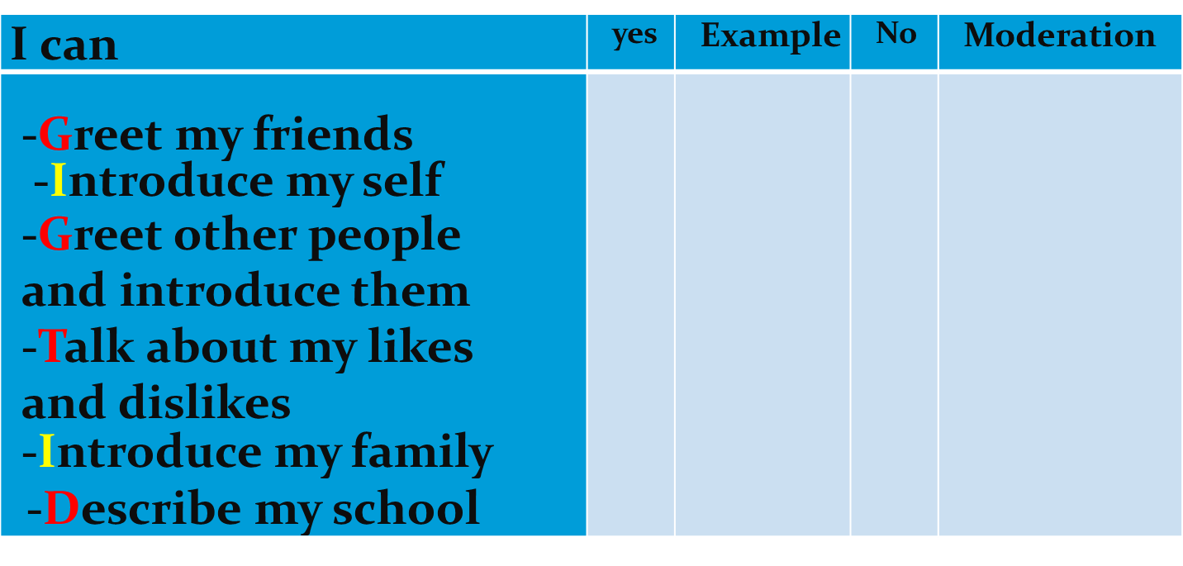
Learner’s assessment grid for the oral competence

Slide 33
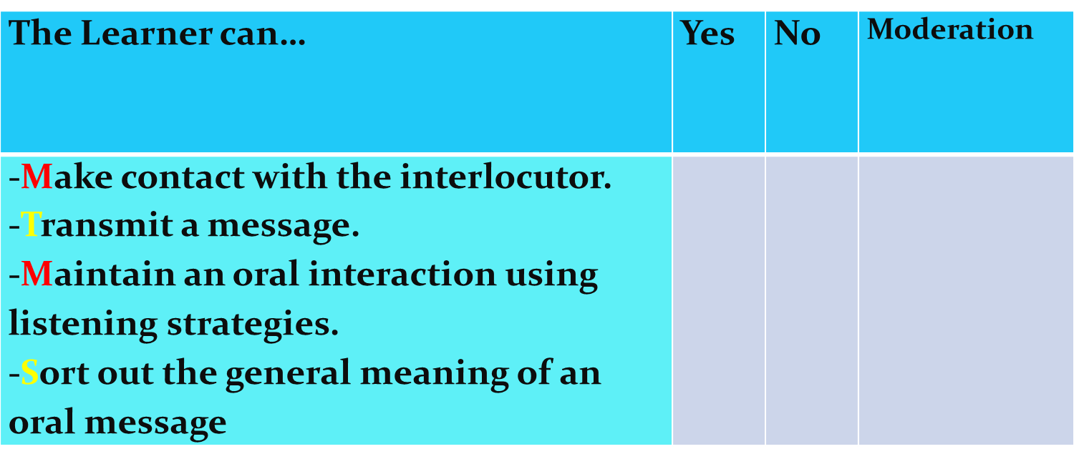
Teacher’s assessment grid for oral interaction

Slide 34
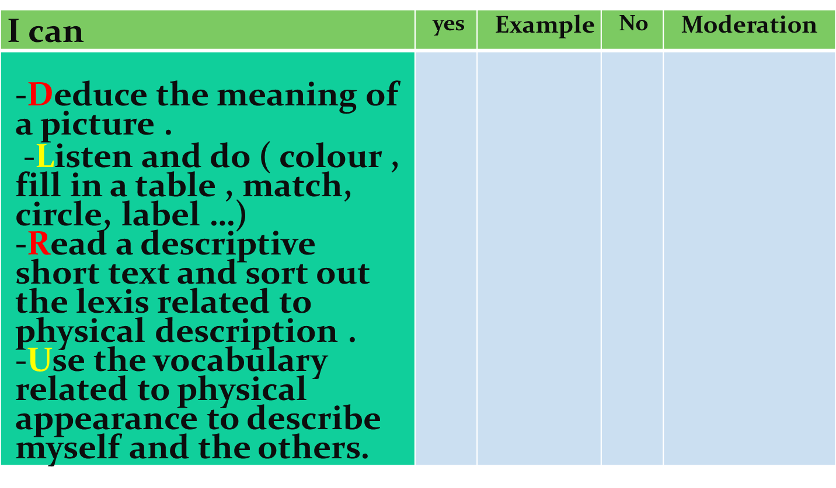
Learner’s assessment grid related to the oral interpretive competence

Slide 35
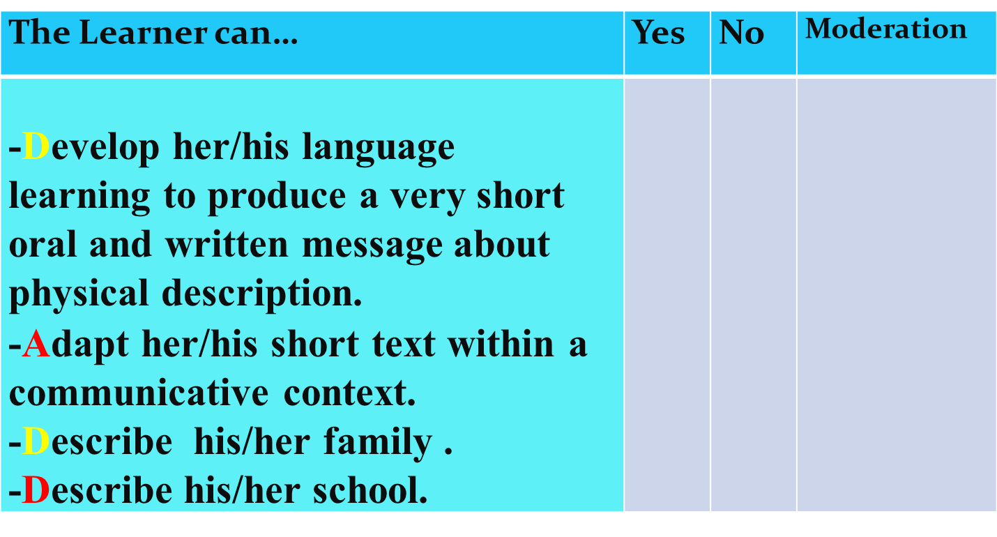
Teacher’s assessment grid related to oral and written messages

Slide 36
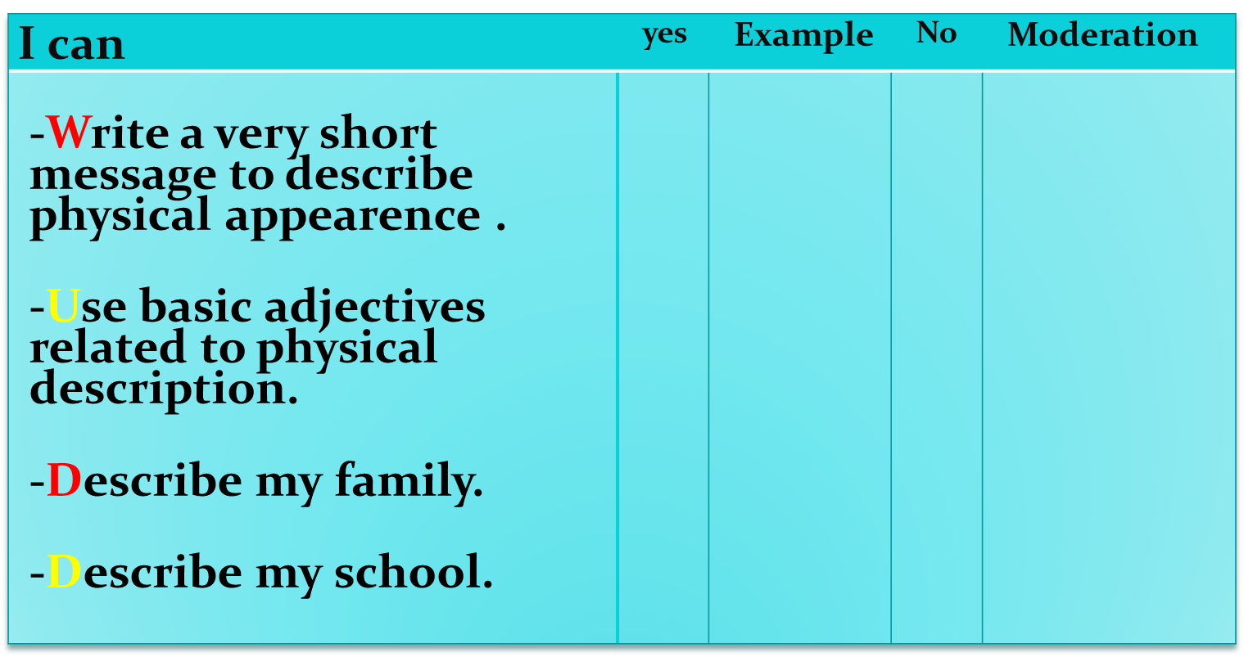
Learner’s assessment grid for productive writing competence

Slide 37
Learner’s assessment grid for cross-curricular competences
1- intellectual competence

Slide 38
Learner’s assessment grid for cross-curricular competences
2-Methodological competence

Slide 39
Learner’s assessment grid for cross-curricular competences
3- Communicative competence

Slide 40
Learner’s assessment grid for cross-curricular competences
4- Personal and Social competence

Slide 41
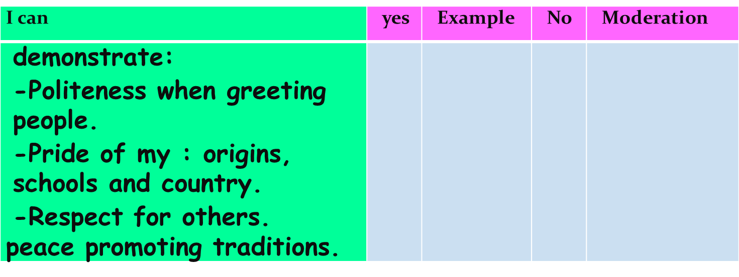
Learner’s assessment grid for values

Slide 42
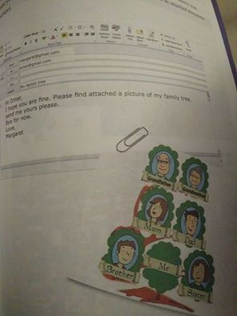
SESSION 6 Situation Three
Related to training for integration (Group Work)
Your e-pal Margaret is now a good friend . She sends family you a picture of her family tree. Draw your family tree ,add information (age,job,likes,…..)and send it as an attached picture document

Slide 43
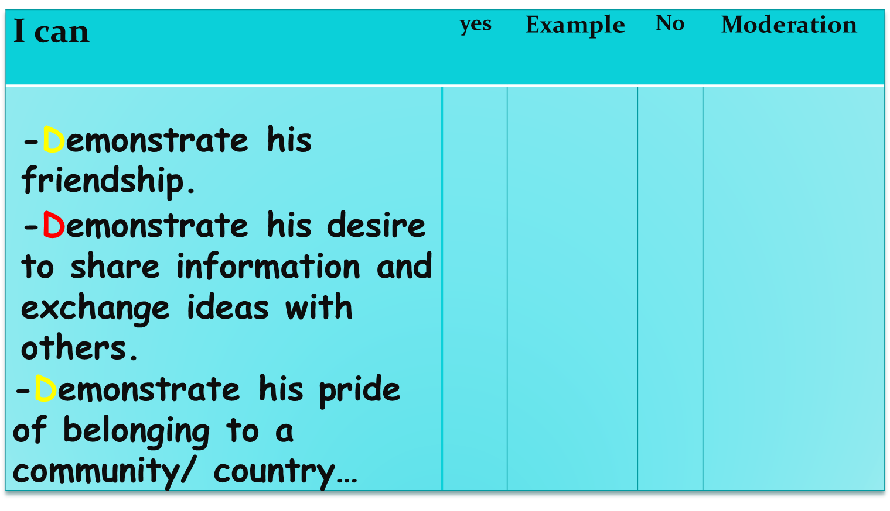
Learner’s assessment grid for values

Slide 44
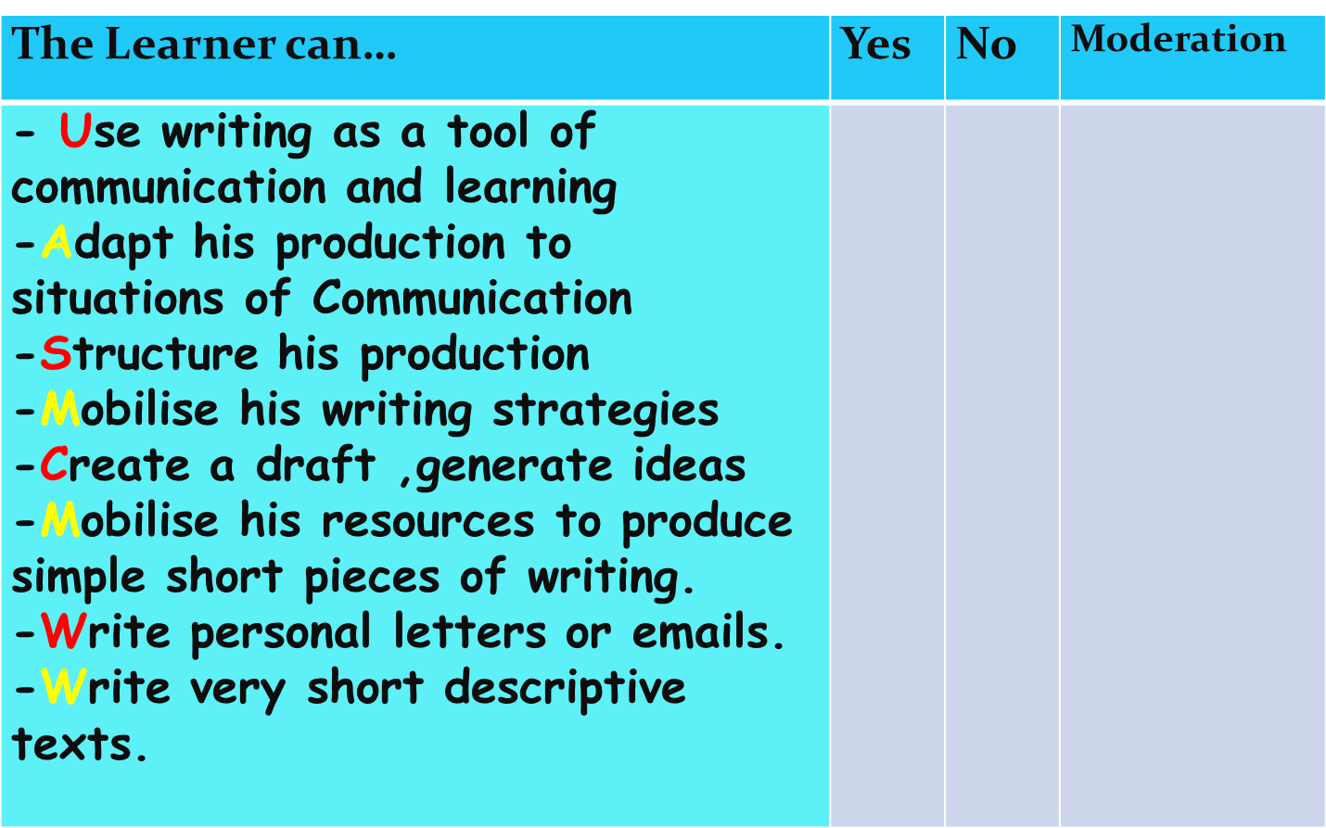
Teacher’s assessment grid written

Slide 45

Session 21: Situation Four
Target Situation for Assessment/ Integration Individual Work
You have a smart and you are using the internet, facebook, viber. You want to make e pals from other countries. You find an email in your e-box.Respond to your e pal and tell him/her about yourself, your family, your village/town and your school.

Slide 46
Session 21: Situation Four
Target Situation for Assessment/ Integration Individual Work
Lesson Focus: Speaking and writing
Learning Objectives:By the end of the lesson ,my learners will be able to greet his friends,introduce himself/herself, his/her family,describe his/her physical appearance, likes and dislikes.
Target Structure: to be /to have/ present simple (like-love-dislike)
Language input: present simple to be, to have ,(Like, love, dislike) helping verb (do) adverb (not) ,pronoun (it) ,wh question (what), vocabulary(name,age,country,hometown,physical appearance,family ,food,clothes,sports and hobbies) functions needed for oral communication with specific vocabulary, etc
Learning Strategies: oral , writing
Resources:: ( visual (flashcards,poster )
Framework: PPU

Slide 47
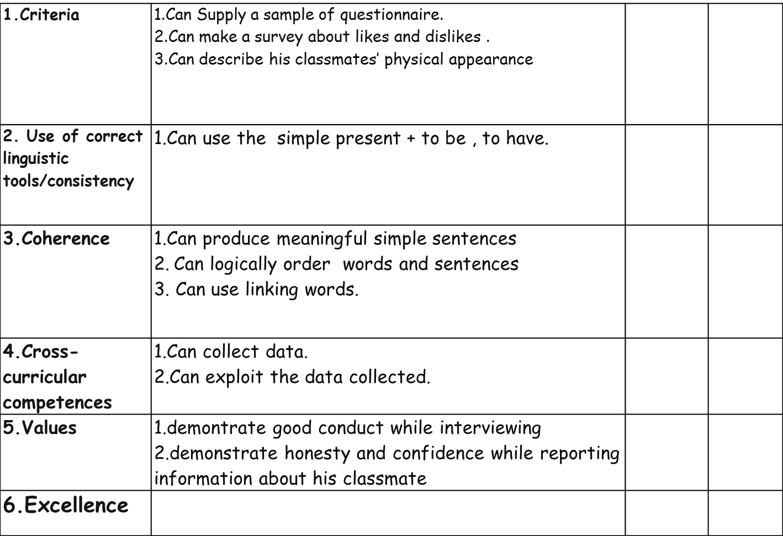
Assessment grid with criteria

