Slide 1
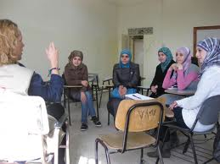
Developing speaking skills in the communicative classroom
Objectives:
to consider what fluent speech consists of
to understand why students have difficulty and suggest some solutions
To analyse examples of speaking activities and discover how tasks can develop fluency
To create an activity which can be used in class
Notes:
Show the slide, make the objectives of the session clear and elicit what they expect the session to cover

Slide 2
Overview: opinions about speaking
Notes:
Worksheet 1. Allow CPs sufficient time to mingle, ask/answer, and as they do, surreptitiously note interesting errors for later feedback. While monitoring it would be particularly useful if an example of negotiation comes up that can be noted, eg one of the CPs asking another to explain further, paraphrase, repeat, spell, define, etc. –for later reference

Slide 3
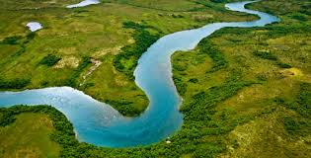
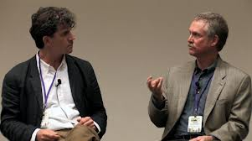
Oral Fluency requires…
Knowledge and skills
1 topic related vocab/structure
2 comprehension
3 use of chunks
4 communicative devices
5 control (& recognition) of pronunciation (intonation)
6 negotiation of understanding
7 use of fillers
8 awareness of discourse
9 strategic competence
10 register
Notes:
In order to speak fluently, what knowledge or skills are essential? CPs in pairs/groups discuss, feedback (allow them to manage the feedback – another opp for trainer to listen, secretly note errors etc), reveal the slide, talk to each point (see trainer’s notes)
(fluent speech flows….like a river)

Slide 4
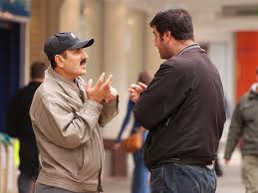
Analysis of a speaking activity
Role of teacher
Closed or open
Whole class, pair or group work
Restricted by material or task
Skills development or language reinforcement
(accuracy or fluency orientated)
Correction
Preparation
Scaffolding
Notes:
In groups CPs analyse the FSW… activity they have just completed, using criteria on the slide. Some terms (closed v open, scaffolding) may need clarifying.

Slide 5
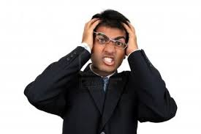
Why do my students find speaking difficult…
They lack vocab or grammar
They struggle with pronunciation
They may misunderstand the task
The topic is boring
The topic may look interesting but they know nothing about it
The task is mechanical, does not require negotiation
They are shy, too conscious of peer reactions, particularly…
Fear of making mistakes
They cannot see the point of the activity, or how it helps them develop
Notes:
Essentially because they do not have the skills or knowledge (or insufficient of each) of the aspects of competence or performance listed in slide 3, but before showing this slide, ask CPs to brainstorm possible reasons why ss find speaking difficult, get feedback. Can be done in groups or in plenary, trainer eliciting, but try to get examples from CPs
OR depending on time, make this a survey, with large groups discussing, making lists, followed by info jigsaw, comparison, plenary feedback

Slide 6
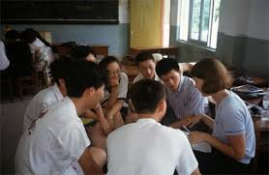
…and how can I help?
Above all, create a secure, non-judgemental learning environment in which errors are ok
Consistently use English yourself & explain why spoken English is vital for ss
Ensure that the fluency activity is part of a planned sequence of lessons which begins with relevant input (vocab, functions, grammar, pron)
Stage/check/exemplify instructions, notes on board
Notes:
Some of the answers they may have come up with.

Slide 7
helping…
Encourage and praise
Teach communicative strategies, also on wall posters
Invite learners to contribute topics
Delayed correction
Find out about students’ interests
Talk about how people learn languages

Slide 8
Information gap
What is it?
How does it work?
Are there variations?
What are the benefits?
Are there problems?
Notes:
Trainer can talk through or ask gps to discuss, feedback.

Slide 9
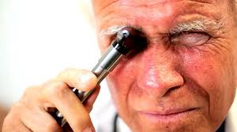
Analysis of speaking materials: your turn
Notes:
CPs in various groups, each with a piece of material for a fluency activity from PW A/B, Tandem, Ur, Klippel, etc. Go to w/sheet two for the task.

